Slide 1

Practical examples of accelerating numerical and ML research with Julia
Jamie Mair (School of Physics & Astronomy)

Slide 2
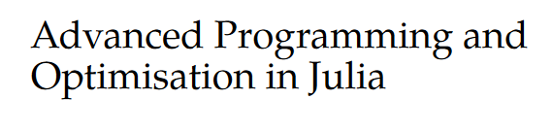
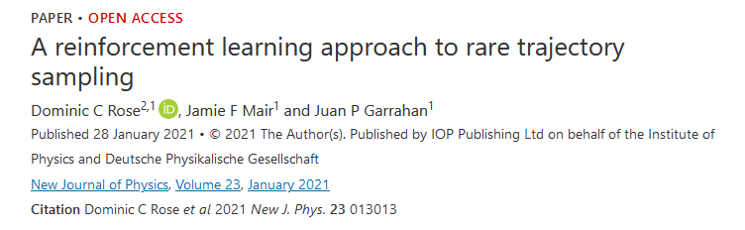
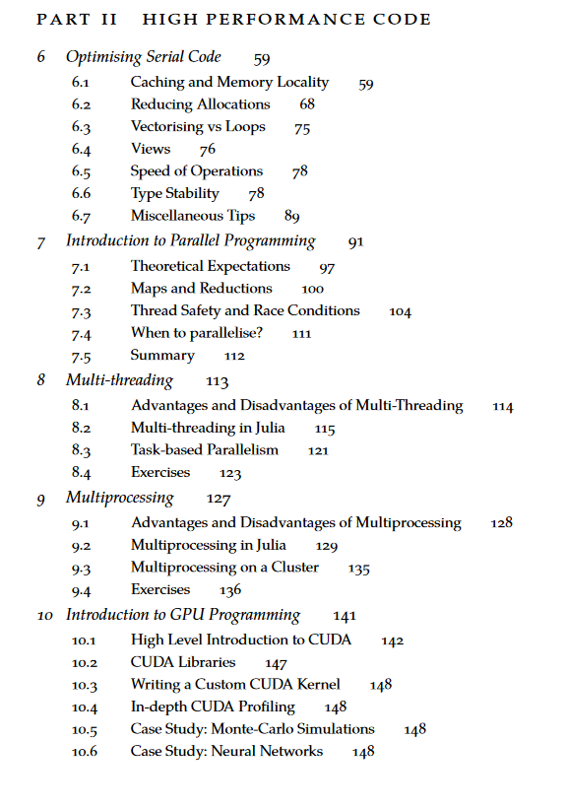
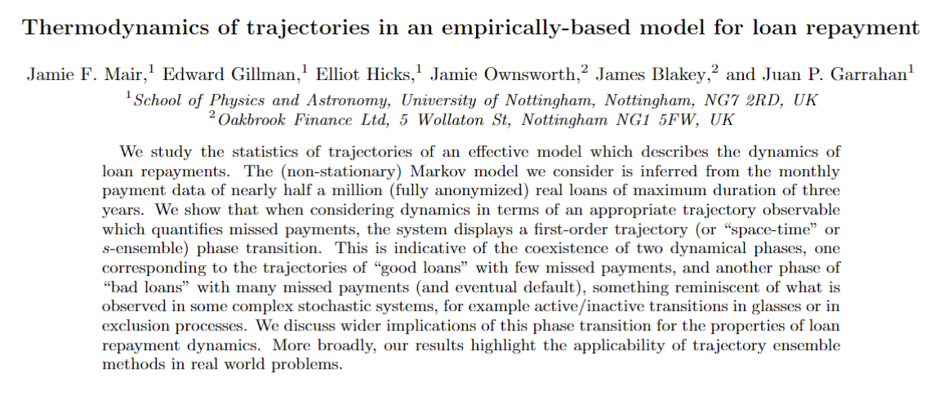
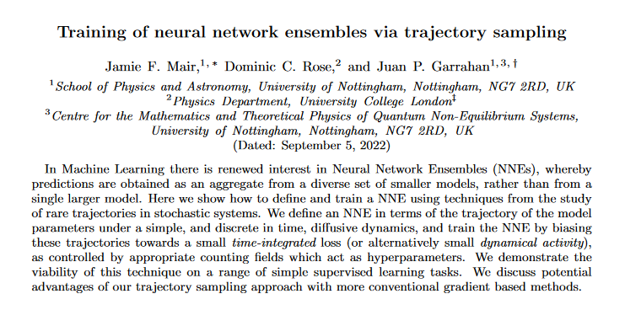

Who am I?
Notes:
Work is at the interface between Machine Learning and Statistical Mechanics
Reinforcement Learning with rare trajectory sampling -> translates a large deviation problem into a reinforcement learning problem. RL requires an interative process of generating simulation data with a model and then processing and training on that data. Can require 10s of millions of epochs, with each epoch requiring hundreds of thousands of calculations. This is then usually repeated many times.
Using machine learning models with transition path sampling, which need to run for a long time, and many repeats to study a spectrum of a parameter.
Some external work with a finance company, applying machine learning methods to real world data.
Some other work, such as applying reinforcement learning in quantum circuits.
Working on a postgraduate level “MPAGS” model which focuses on teaching a basic level of high performance computing to new PhD/Masters level students using Julia
Most of the techniques applied require a large scale to work, and to research. One needs to often see how a system behaves under varying parameters, involving a lot of randomness, so most results require large numbers of repeats. Most applications need to be able to scale to run on a cluster or at least a GPU. Most code is custom, and does not always have a package that will do what you want.

Slide 3
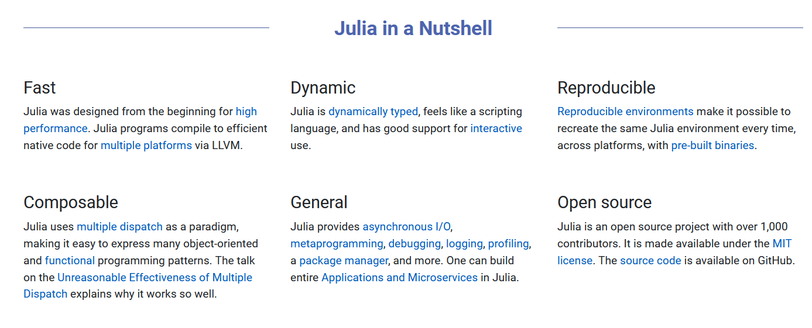
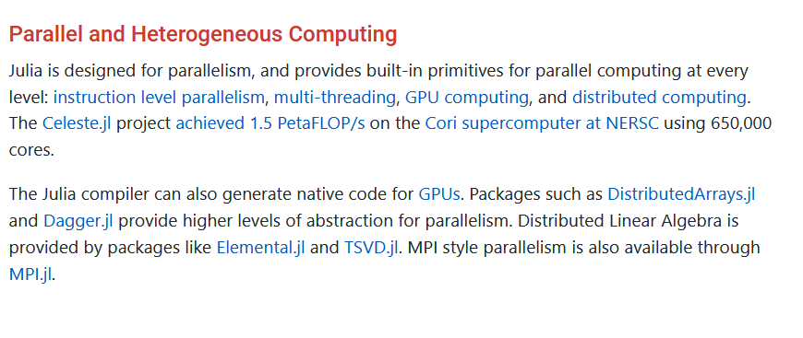

What is Julia?
https://julialang.org/

Slide 4
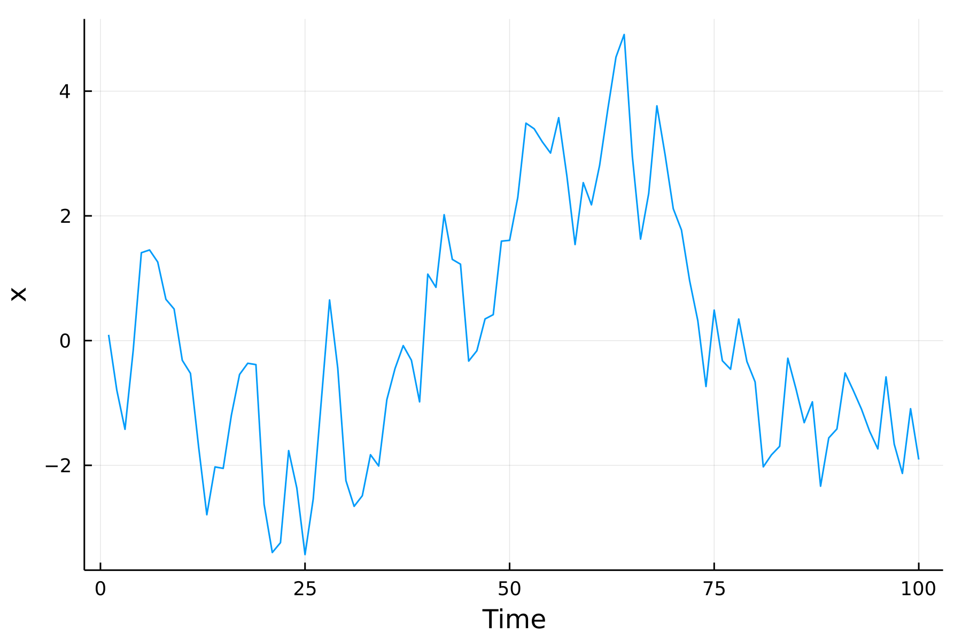
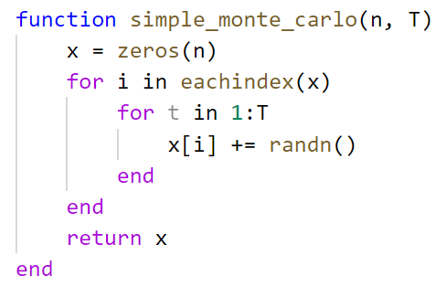
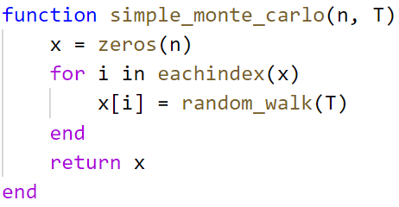

“Embarrassingly Parallel” Monte Carlo
Random walk of a single particle over a number of discrete time steps.
We want to get $n$ samples of the final position of the walk after $T$ time steps.
Simple problem allows us to explore different types of parallelisation.
Generic independent function

Slide 5
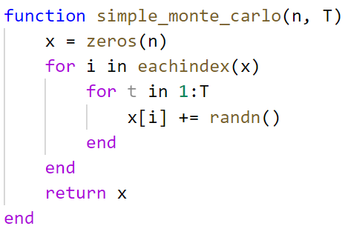
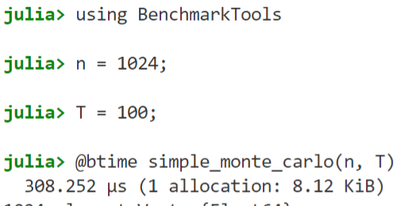
Is it fast?

Slide 6
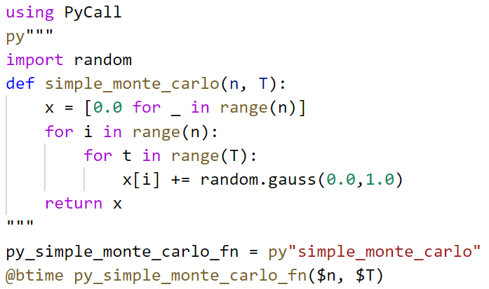

Is it fast? (vs native Python)
~150 times faster****

Slide 7
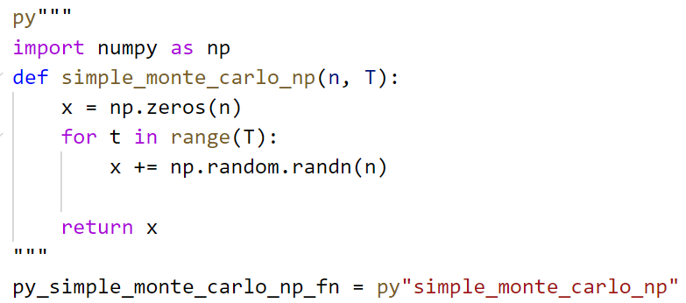

Is it fast? (vs numpy)
~7 times faster****

Slide 8
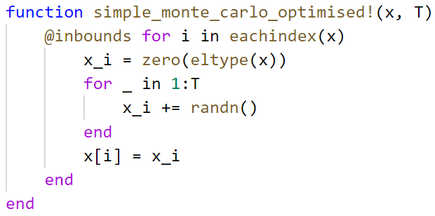
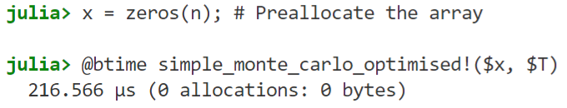
Can it be faster?
~30% faster

Slide 9
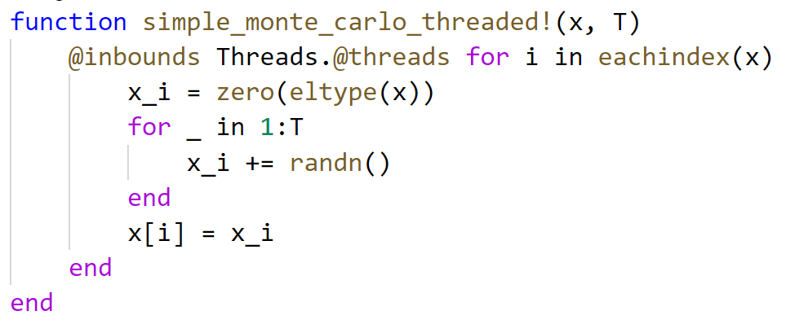
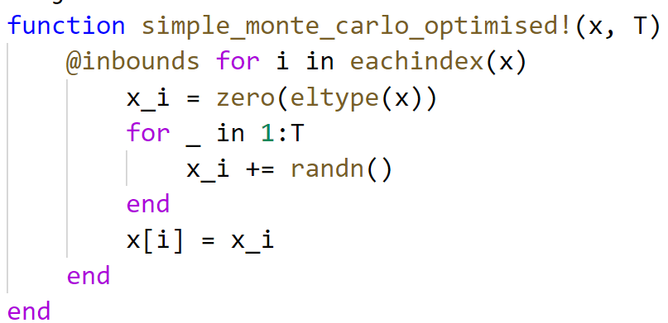

Using multiple cores
~4.7 times faster, using 8 cores

Slide 10
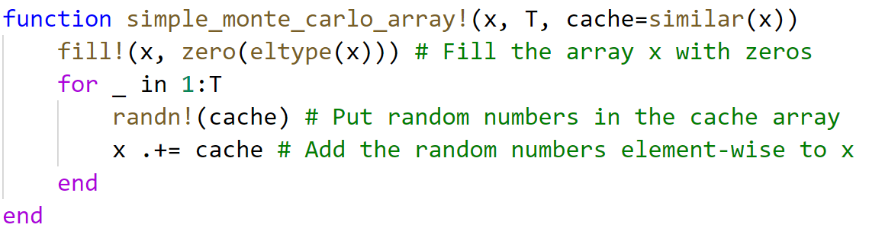
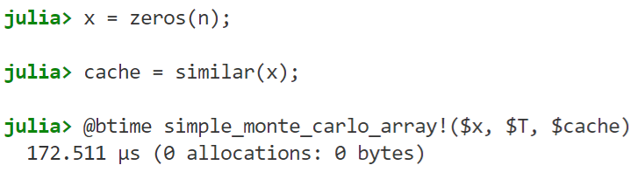
What about “vectorisation”?
~1.25 times faster (single core)

Slide 11

Using a GPU
Same code as before!
Only the input types changed, and Julia compiled a GPU version of the function.
There’s a catch, uses Float32 by default.
About 1.4 times slower than CPU using Float32.
GPUs are much slower than CPUs, but make up for this in data parallelism.

Slide 12
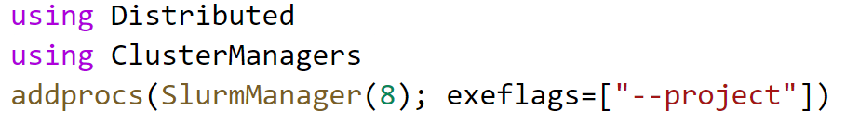

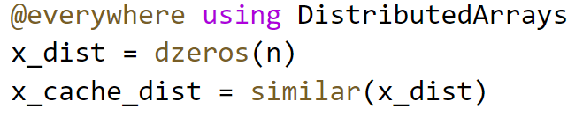
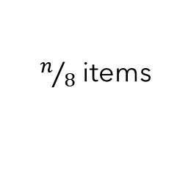

Scaling up to a cluster
On a SLURM cluster
Worker 1
Worker 2
$$⋯$$
Worker 7
Worker 8
$n/8$ items

Slide 13
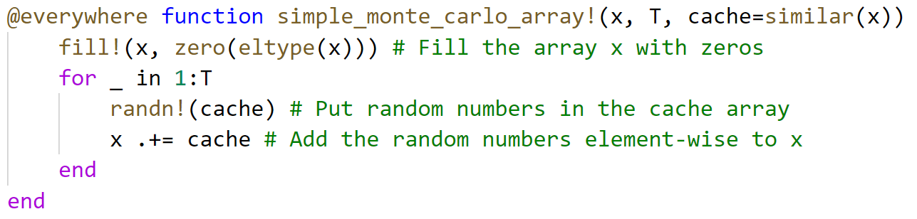
Scaling up to a cluster
1) Make all functions available to each worker, using the @everywhere macro

Slide 14
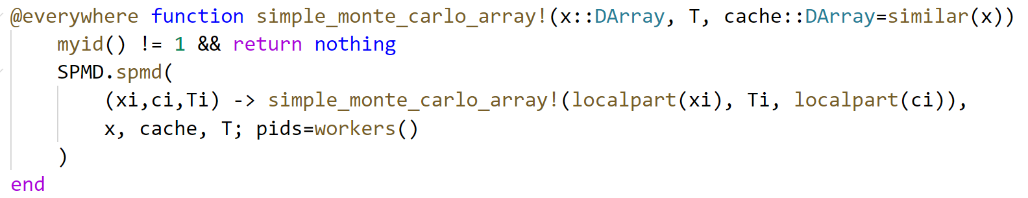
Scaling up to a cluster
2) Specialise on the DArray type, with some boilerplate for Single Program Multiple Data. Lifted from the DistributedArrays.jl documentation.
This code runs our standard array function on each local part of the distributed array. This only affects the function when using DArray datatypes.

